Slide 1
Naive Bayes
Types of Naive Bayes Classifiers
Requirements:
Probability, Bayes Theorem, Data Distribution

Slide 2
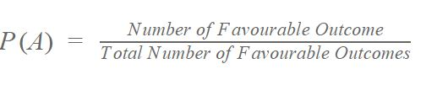

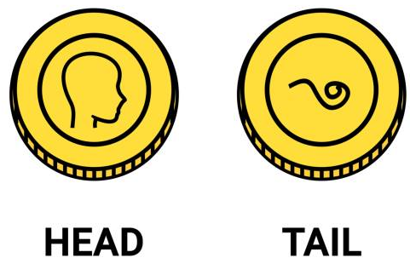
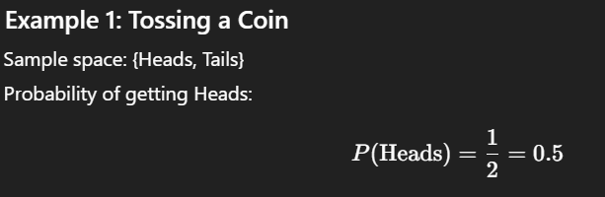
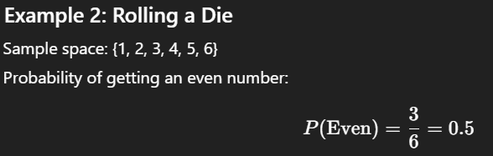
Probability
Probability is the measure of the likelihood that an event will occur, between 0 and 1.

Slide 3
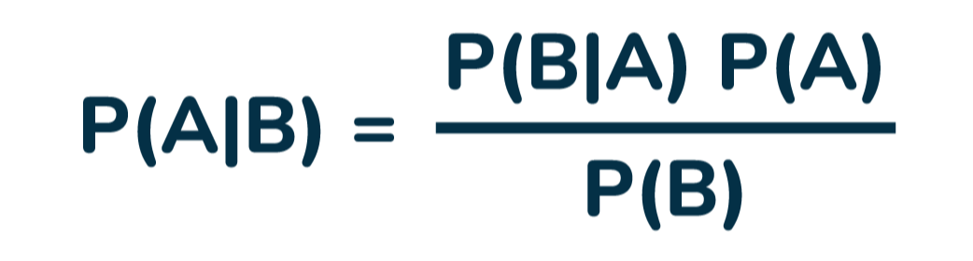
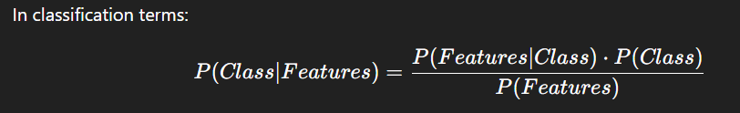
Bays Theorem
Fruit = { red, sweet, size} = ?
Fruits | Red | Sweet | Size | Total
Apple | 10 | 20 | 0 | 5 (T/Apples
Banana | 20 | 30 | 50 | 30 (T/banana
Others | 100 | 200 | 300 | 100 (T/others
Total | 90 (T/red apples | 250 | 350 | 135 (T/fruits)
P (red | apple) = P (apple | red) . P (red)
P(apple)
(10 / 90) . (90/135)
(5/135)
∗∗2∗∗
The posterior probability score is 2× more likely than baseline.
In a binary classification: If you calculate similar score for another class, the one with higher score wins.

Slide 4
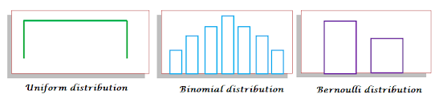
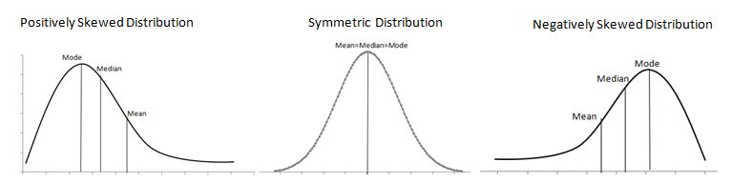
Data Distribution

Slide 5
Naïve Bays Algorithm
A probabilistic classifier based on Bayes’ Theorem with a strong (naive) assumption that features are independent given the class label.
Note: Naive Bayes is only used for classification, not for regression.
1. Gaussian Naive Bayes
Used when features follow a normal distribution (e.g., continuous features).
2. Multinomial Naive Bayes
Best for count features like word counts in NLP (e.g., spam classification).
Common for text classification tasks.
3. Bernoulli Naive Bayes
Works with binary/boolean features (e.g., whether a word occurs or not).

Slide 6
Naïve Bays Algorithm Working
Goal: Predict if someone will "Buy" based on "Age" and "Income"
Age | Income | Buy
Young | High | No
Young | Medium | Yes
Old | Low | Yes
Young | Low | No
Old | High | Yes
Now, we want to predict for:
Age = Young, Income = Low → Will they Buy?

Slide 7
Naïve Bays Algorithm Working
Age | Income | Buy
Young | High | No
Young | Medium | Yes
Old | Low | Yes
Young | Low | No
Old | High | Yes
Step 1: Count how often each label appears
Yes = 3
No = 2
→ So 3 people said Yes, 2 said No

Slide 8
Naïve Bays Algorithm Working
Age | Income | Buy
Young | High | No
Young | Medium | Yes
Old | Low | Yes
Young | Low | No
Old | High | Yes
Step 2: Look at people who said Yes:
How many of them are Young? → 1 out of 3
How many of them have Low Income? → 1 out of 3
Now do the same for people who said No:
How many of them are Young? → 2 out of 2
How many have Low Income? → 1 out of 2

Slide 9
Naïve Bays Algorithm Working
Age | Income | Buy
Young | High | No
Young | Medium | Yes
Old | Low | Yes
Young | Low | No
Old | High | Yes
Step 3: Compare probabilities (intuitively)
For Yes:
"Young" is less common (1 out of 3)
"Low" income is less common (1 out of 3) → So not super confident it's Yes
For No:
"Young" is very common (2 out of 2)
"Low" income is somewhat common (1 out of 2) → Looks more likely to be No

Slide 10
Naïve Bays Algorithm Working
Age | Income | Buy
Young | High | No
Young | Medium | Yes
Old | Low | Yes
Young | Low | No
Old | High | Yes
Final Answer: No
Because based on past data, Young + Low Income people mostly said No.

Slide 11
Applications
Spam Detection
User Behavior Prediction
Sentiment Analysis
Image Classification
Document Classification
Language Detection
Medical Diagnosis
Recommendation Systems
Student Performance Prediction

Slide 12
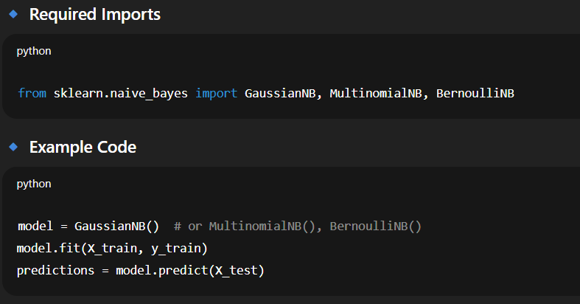
Code Implementation

